Slide 1
Chapter 4: Computer Architecture and the PEP/8 Virtual Computer
Notes:
In this chapter we are going to learn more about computer architecture by working with a PEP/8 virtual computer. This computer was designed to help you understand the fundamental concepts that apply to most computer systems.
The PEP/8 architecture illustrates basic computer organization and many fundamental concepts, including the fetch-decode-execute cycle, the data path, buses, registers, and of course, the CPU. A very simple architecture, PEP/8 and its ISA, are presented to allow the you to gain a full understanding of the basic architectural organization involved in program execution on any computer architecture. PEP/8 exhibits the classical von Neumann design, and includes a program counter, an accumulator, an instruction register, main memory, and multiple addressing modes. Machine Language and Assembly Language programming are introduced to reinforce the concepts of instruction format, instruction mode, data format, and program control. (This is not an assembly language textbook and was not designed to provide a practical course in assembly language programming for any real-world architecture.) The primary objective in introducing assembly is to further the understanding of computer architecture in general. In this chapter, we will write machine language programs for its ISA, and run the code on the PEP/8 architecture. In the next chapter, we will write assembly language programs using the same simulator.

Slide 2
Chapter 4 Objectives
Learn the components common to every modern computer system.
Be able to explain how each component contributes to program execution.
Understand a simple architecture invented to illuminate these basic concepts, and how it relates to some real architectures.
Know how the program assembly process works.
Notes:
Learn the components common to every modern computer system.
Be able to explain how each component contributes to program execution.
Understand a simple architecture invented to illuminate these basic concepts, and how it relates to some real architectures.
Know how the program assembly process works.

Slide 3
Hardware
Computer - composed of 4 major components:
Central Processing Unit (CPU
instructions are fetched and executed
Memory system
Programs and data are stored
Input Devices
Output Devices
(I/O) system is responsible for input and output data to and from the memory system
Notes:
As discussed in Chapter 1, a computer is basically composed of 4 major components:
The Central Processing Unit (CPU) where instructions are fetched and executed
The Memory system where Programs and data are stored
And Input Devices & Output Devices
Or the (I/O) system, which is responsible for input and output data to and from the memory system.

Slide 4
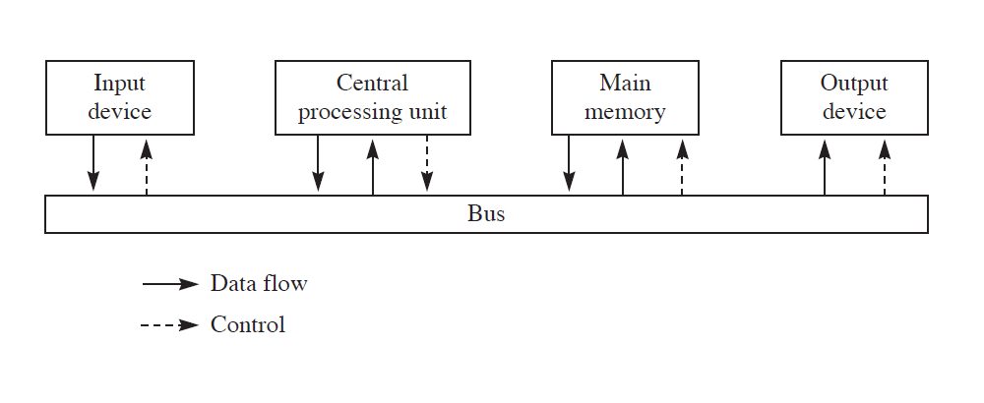
Block Diagram of the Pep/8 Virtual Computer
Overall system structure is shown in the following diagram:
Notes:
The Overall system structure can be shown in this familiar diagram.
The solid lines show the data flow and the dashed lines show the flow of control.
The bus, actually multiple busses, carry the data between the four components.

Slide 5
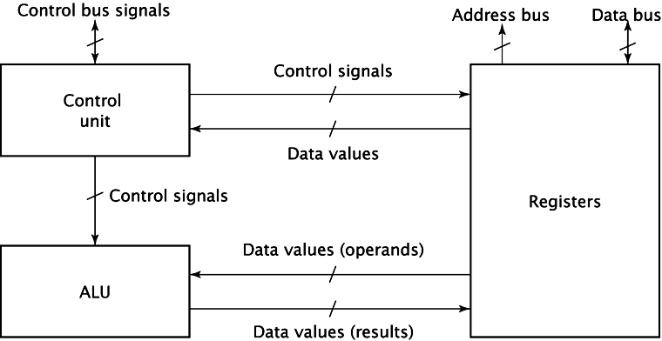
CPU Organization
Three basic components:
1) Registers
Store data in the CPU
Some are general purpose, some have specific purposes
program counter (PC) register
instruction register (IR)
2) ALU (Arithmetic Logic Unit)
Implements arithmetic and logic instructions
3) Control unit
Controls operation of the other CPU components
Asserts information on the control lines (READ, WRITE, IO/M)
Notes:
Let’s look closer at the CPU
Again, it has three basic components: (1) registers, (2) control unit, and (3) ALU.
The Registers are used to store data in the CPU. Some are general purpose, some have specific purposes. For example, during fetch CPU places contents of program counter (PC) register on address bus then stores fetched instruction in instruction register (IR).
The ALU (arithmetic/logic unit) implements arithmetic and logic instructions.
The Control unit controls operation of the other CPU components. It Asserts information on the control lines (READ, WRITE, IO/M) which causes registers to load data, clear contents, output contents, etc.

Slide 6
PEP/8 CPU
Our virtual computer contains six specialized registers:
4-bit Status Register (NZVC)
16-bit accumulator (A)
16-bit index register (X)
16-bit program counter (PC)
16-bit stack pointer (SP)
24-bit instruction register (IR)
Notes:
Our virtual computer contains six specialized registers:
The 4-bit Status Register holds the values for (NZVC) These are set by the CPU when these conditions occur N – negative, Z – zero, V – overflow, C – carry and it is up to the software to examine them and take the appropriate actions
The 16-bit accumulator (A) “accumulates” the result of an operation.
The16-bit index register (X) is for indexing the elements of an array or memory locations
The 16-bit program counter (PC) or Program counter, points to the next instruction in memory.
The 16-bit stack pointer (SP) is for accessing the elements on the run-time stack.
The 24-bit instruction register (IR) holds the current instruction after it has been accessed from memory.

Slide 7
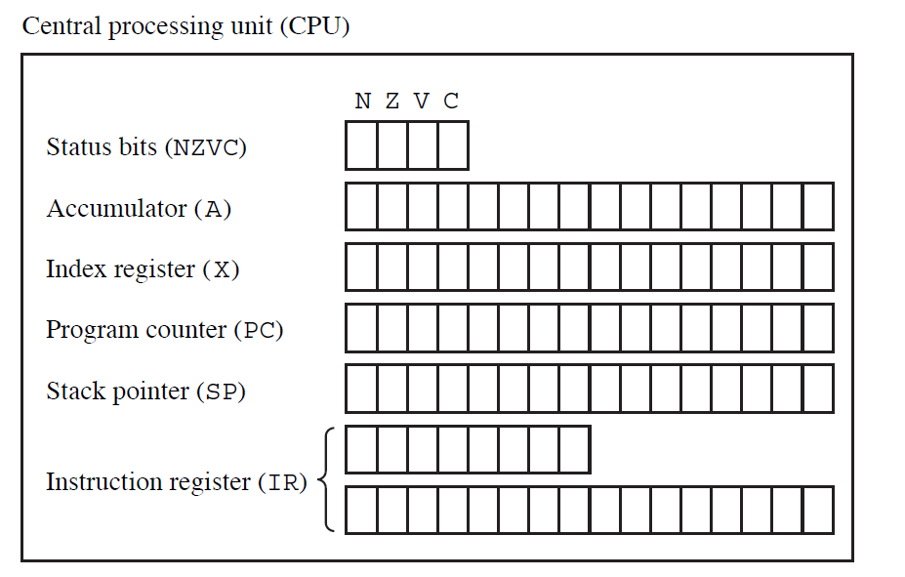
PEP/8 CPU
PEP/8 CPU registers
Notes:
Here each of these registers are shown graphically. It shows the number of bits in each register. Note the Instruction Register is divided onto two lines.
Some of the instructions only use the first 8-bits and are called unary instructions. Some require an operand in the following 16 – bits. These are not unary instructions.

Slide 8
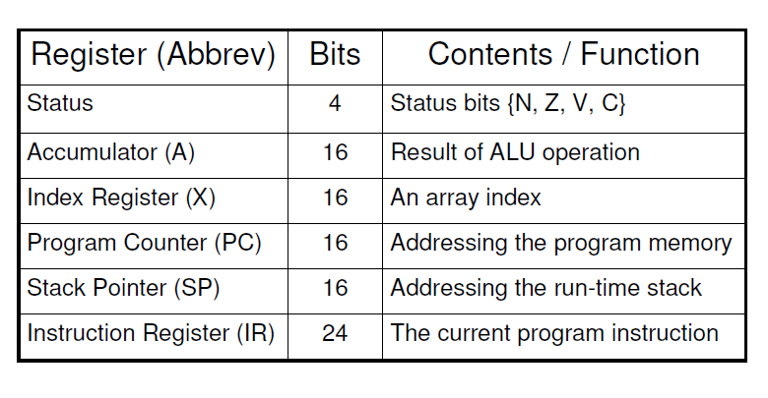
PEP/8 CPU
PEP/8 CPU register definitions
Notes:
Here are the definitions in a chart form for reference.

Slide 9
Main Memory System
Memory system
Array of memory locations
Each store a multiple-bit binary data (typically 8 bits called a byte).
Each are selectable by address for either read or write operation
Normally has
address input for the address to select the location
data input for the data to the written to the location
data output for the data read from the location
chip enable control to enable the entire memory
read/write control to start read or write operation
Notes:
A memory system can be viewed as an array of memory locations each of which can store a multiple-bit binary data (typically 8 bits called a byte).
Memory locations are selected by address for either read or write operation.
It normally has
address input for the address to select the location
data input for the data to the written to the location
data output for the data read from the location
chip enable control to enable the entire memory
read/write control to start read or write operation

Slide 10
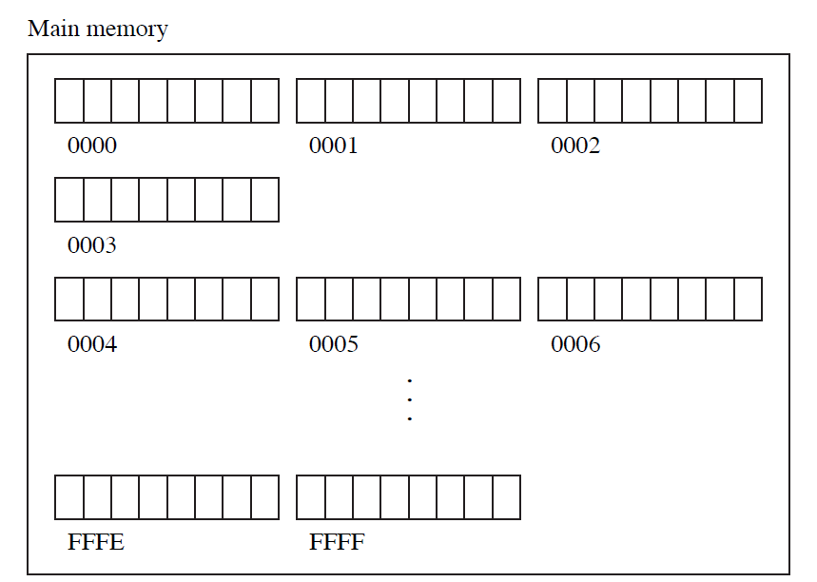
Memory Organization
Computer memory
Linear array of addressable storage cells that are similar to registers
Can be byte-addressable
Can be word-addressable
typical word is two or more bytes
PEP/8 main memory:
65,536 Byte-size storage locations
65,536 = 2^16, meaning
16-bit addresses
or 4 hex digits
0000 to FFFF
Notes:
Computer memory consists of a linear array of addressable storage cells that are similar to registers.
Memory can be byte-addressable, or word-addressable, where a word typically consists of two or more bytes.
Our PEP/8 main memory has 65,536 Byte-size storage locations
65,536 = 2^16, meaning we have 16-bit addresses or 4 hex digits , 0000 to FFFF
Remember this has to hold the program and the variables. – It is small!

Slide 11
Memory Organization
PEP/8 main memory
Notes:
The instructions in the Instruction register will need to access these memory locations by address. No more nifty variable names!
We will need to know the difference between a memory address and the contents of the memory. Remember pointers!
Also the memory cells do not know what is in them int, float, char or an instruction. They are all 0s and 1s at an address.

Slide 12
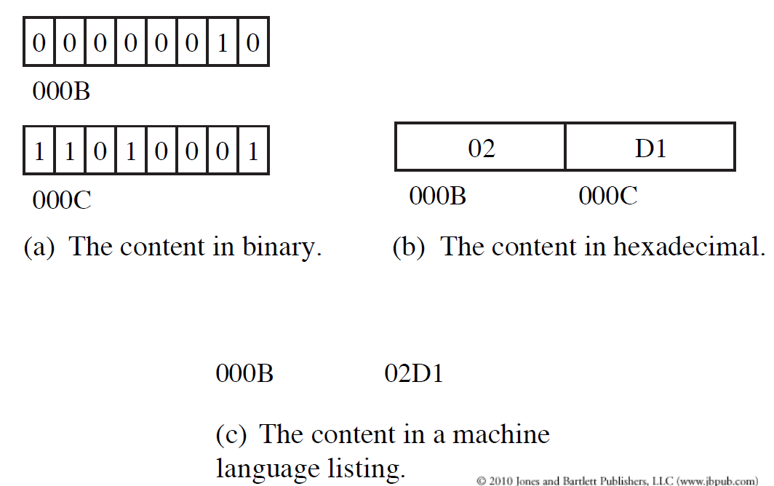
Memory Organization
PEP/8 main memory
Address
Notes:
This diagram shows three different ways of viewing two locations in memory.
In a the content of memory addresses 000B & 000C are shown in binary form.
In b the content of 000B & 000C are shown in hexadecimal form.
Finally, in c both are viewed together as an word in a machine language listing.
Please study this slide, until you understand that these are all the same.

Slide 13
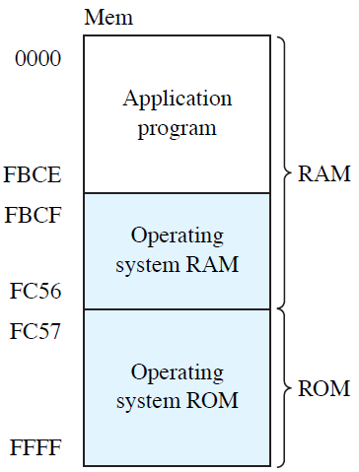
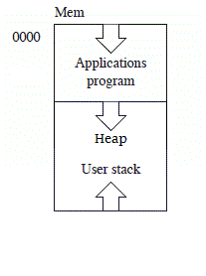
Memory Organization
Memory map for PEP/8:
Notes:
We need to track the memory and the addresses closely because we need to know where everything is located.
Let’s look at the memory map for the PEP/8.
The operating system RAM & ROM is located at the bottom of the memory space. It has 1072 bytes reserved for its use from location FBCE to FFFF
Your program will be loaded in at 0000. After your program will be the fixed memory locations for variables. Below that will be the heap for your pointers.
The run-time stack for your program will begin at FBCD and grow upwards from there. So you can see that the program size, memory for variables, and the size of the stack will all need to be accounted for to be assured that the run-time stack and the heap do not overwrite each other.

Slide 14
I/O Subsystem
A computer communicates with the outside world through its input/output (I/O) subsystem.
I/O devices connect to the CPU through various interfaces.
PEP/8 Input devices
Text file (or GUI window)
Keyboard
PEP/8 Output devices
Text file (or new GUI window)
Screen
Notes:
A computer communicates with the outside world through its input/output (I/O) subsystem.
I/O devices connect to the CPU through various interfaces.
Our PEP/8 has two Input devices one will be a Text file (or GUI window) and the other is the keyboard
It has the same two Output devices.

Slide 15
I/O Subsystem
Notes:
There are two modes for handling input & output, the interactive mode and the batch mode.
The interactive mode will ask for and receive input from the keyboard and the mouse. The output is displayed immediately on the screen.
In the batch mode, the input must be prepared before you run the program and the output may go to a file.

Slide 16
Data and Control (system busses)
Four major components are connected by:
Address bus - provides the address for the memory location to be addressed for read and write
Data bus - transfers data
from CPU or I/O to memory
from memory to CPU or I/O
Control bus - consists of
many control signals to control overall system operations
many status data from memory and I/0 devices
Notes:
The four major components are connected by
an address bus which provides the address for the memory location to be addressed for read and write
a data bus which transfer data
from CPU or I/O to the memory and
from the memory to the CPU or I/O
a control bus which consists of
many control signals to control the overall system operations
many status data from the memory and I/0 devices

Slide 17
Data and Control (PEP/8)
Control: always flows from CPU others
Data: In Pep/8, Memory must always be either the source or the destination
Other architectures may allow other transfer modes
Notes:
In the PEP/8 the control always flows from CPU to others
In Pep/8, Memory must always be either the source or the destination
Other architectures may allow other transfer modes

Slide 18
Data and Control (PEP/8)
Notes:
There is no direct flow between input and the output. All of the computing happens in the CPU. A large amount of the CPU’s time is spent moving data from place to place.

Slide 19
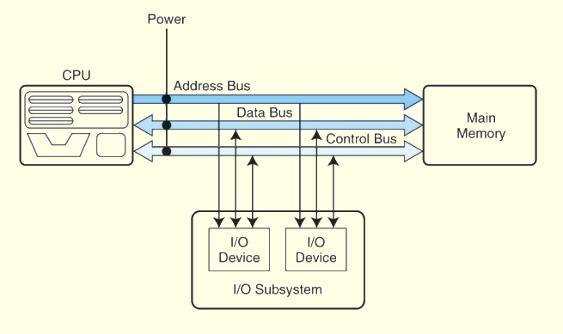
System Busses
Buses consist of:
Data lines
convey bits from one device to another
Control lines
determine the direction of data flow
Address lines
determine the location of the source or destination of the data
Notes:
Buses consist of data lines, control lines, and address lines.
While the data lines convey bits from one device to another, control lines determine the direction of data flow, and when each device can access the bus.
Address lines determine the location of the source or destination of the data.

Slide 20
The PEP/8 Virtual computer
Bring together many of the ideas using a very simple model computer
PEP/8 was designed for illustrating basic computer system concepts
Too simple to do anything useful
An understanding of PEP/8 functions will help comprehend more complex system architectures
Notes:
We can now bring together many of the ideas that we have discussed to this point using a very simple model computer.
Our model computer, the PEP/8 was designed for the singular purpose of illustrating basic computer system concepts.
While this system is too simple to do anything useful in the real world, a deep understanding of its functions will enable you to comprehend system architectures that are much more complex

Slide 21
The PEP/8 Virtual computer
What do we mean “Virtual Machine”?
Conceptual architecture is defined
Instruction set (language) is defined
No physical machine exists
Operation is simulated by software
Notes:
What do we mean “Virtual Machine”?
The Conceptual architecture and Instruction set (language) are defined.
No physical machine exists so the operation is simulated by software.

Slide 22
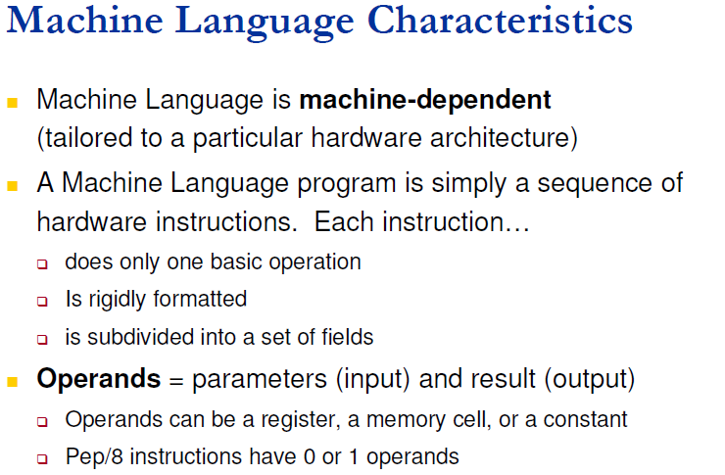
The PEP/8 Virtual computer instructions
Notes:
Let’s look at machine language characteristics. In chapter 1 we learned it is machine-dependent or tailored to a particular hardware architecture.
The program is a sequence of instructions that each only do one basic operation. Each instruction is rigidly formatted and is subdivided into a set of fields.
The Operands represent the parameters coming in and the results going out. PEP/8 instructions have 0 or 1 operand.

Slide 23
The PEP/8 Virtual computer
Instruction Set Architecture (ISA)
specifies the format of its instructions
Specifies the primitive operations that the machine can perform
ISA is an interface between a computer’s hardware and its software
Some ISAs include hundreds of different instructions for processing data and controlling program execution
PEP/8 ISA consists of 39 instructions
Notes:
A computer’s instruction set architecture (ISA) specifies the format of its instructions and the primitive operations that the machine can perform.
The ISA is an interface between a computer’s hardware and its software.
Some ISAs include hundreds of different instructions for processing data and controlling program execution.
The PEP/8 ISA consists of only 39 instructions

Slide 24
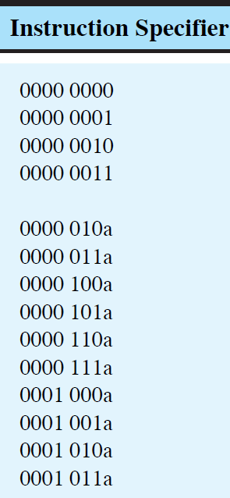
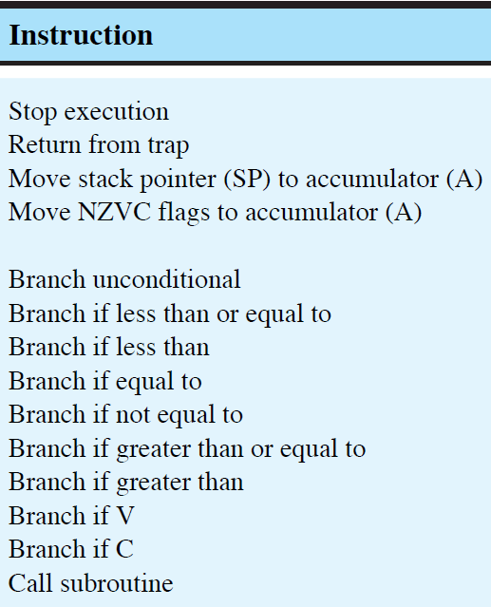

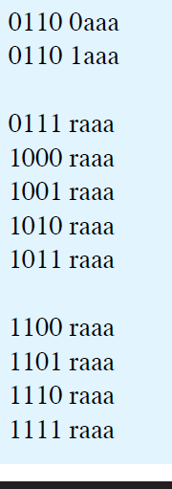
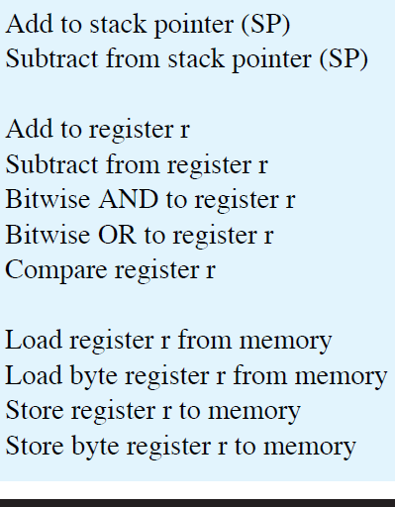
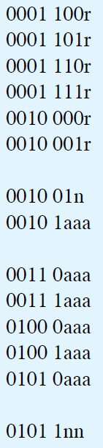
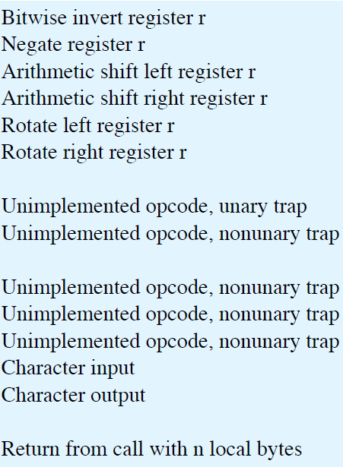
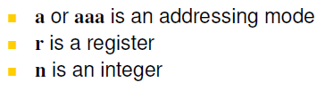
The PEP/8 Virtual computer instruction list
Notes:
Here is the list of PEP/8s Instruction Set. It is also found on the inside cover of your textbook. You will need to use this instruction set to program the PEP/8.
It looks a lot different than those HOL6 software languages we have been using – doesn’t it.

Slide 25
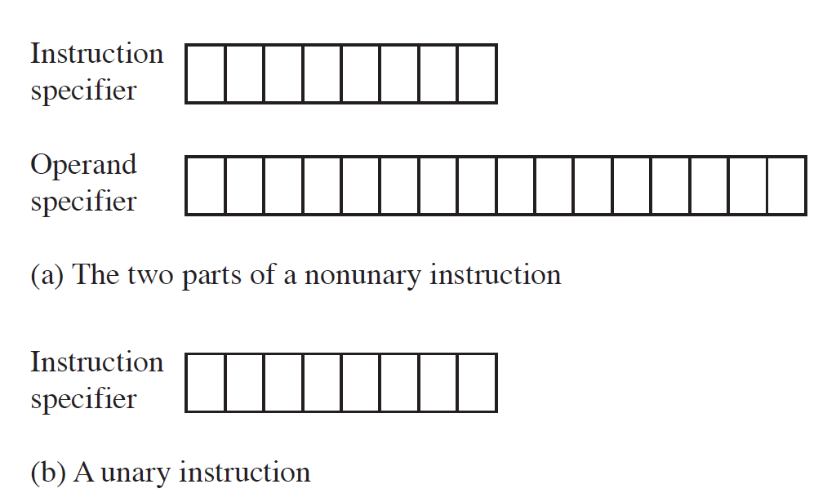
The PEP/8 Virtual computer instructions
This is the format of a PEP/8 instruction:
Notes:
This is the format of a PEP/8 instruction. The instruction specifier has 8 bits. Unary instructions which are noted with a U in the front of the text only use this part of the instruction.
The other instructions have an instruction specifier and an operand specified in the remaining 16 bits.

Slide 26
The PEP/8 Virtual computer instructions
Notes:
When reviewing the Instruction Set, you will note that some instructions have r, a, or aaa after them. This specifies where the processor should do its operation.
If there is an a or aaa, it is indicating how the operand in the operand specifier should be used to determine an address in memory.
If there is an r, it is indicating a register – 0 for the accumulator and 1 for the index.

Slide 27
Addressing Modes
How many ways can the processor access memory locations?
Eight for 3-bit aaa field for non-unary instructions:
Immediate
Instruction specifies actual value to use, not address
Direct
Instruction includes absolute memory address
Indirect
Instruction contains an address that contains an address. (which means "read address 5, use its contents as an address to fetch"
Relative (Stack-relative, Stack-relative deferred)
Instruction operand is an offset from some base address
Index (Stack-index, Stack-index deferred)
Instruction operand supplies offset from an index register
Two for 1-bit a field for unary instructions
Immediate
Indexed
This chapter focuses only on the direct addressing mode.
Notes:
How many ways can the processor access memory locations?
Eight for 3-bit aaa field for non-unary instructions:
Immediate
Instruction specifies actual value to use, not address.
Direct
Instruction includes absolute memory address .
Indirect
Instruction contains an address that contains an address. (which means "read address 5, use its contents as an address to fetch".
Relative (Stack-relative, Stack-relative deferred)
Instruction operand is an offset from some base address.
Index (Stack-index, Stack-index deferred)
Instruction operand supplies offset from an index register.
Two for 1-bit a field for unary instructions
Immediate
Indexed
This chapter focuses on the direct addressing mode.

Slide 28
PEP/8 Machine Instruction
Notes:
Let’s look at a complete machine instruction, piece by piece.
The first four bits 0111, represent ADDr or Add to r. A register number must replace the r. 0 for the accumulator or 1 for the index register.
In this case, R is 0 which indicates the Accumulator. The three a’s are 001 which indicates direct addressing. That is all we will be using in this chapter. We will get to the others later.
Direct addressing means that the operand specifier has the absolute address in main memory of the cell that contains the value to be used.
So the operand specifier contains 0005, which means to add the value at memory address 0005 to the accumulator and store the result in the accumulator.

Slide 29
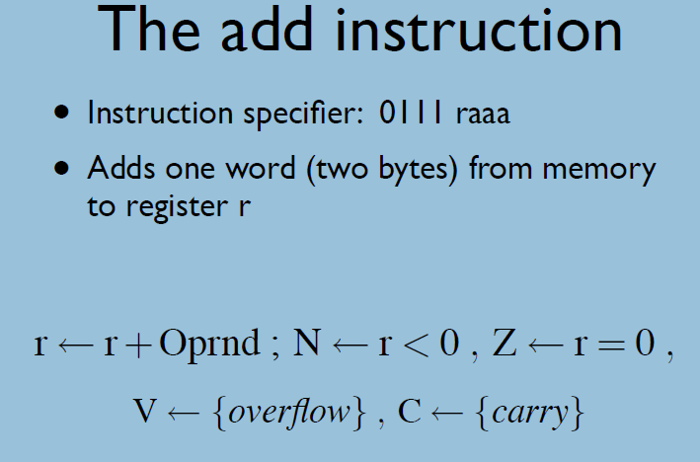
PEP/8 Machine Instruction
What happens when the Add instruction is executed?
Notes:
This is what happens when the ADD is executed.
This is the RTL or Register Transfer Language expression for it.
It says that r gets r + the Operand.
The status bit N gets set to 1 if the result in r is less that zero or negative.
The status bit Z gets set to 1 if the result in r equals zero.
The status bit V gets set to 1 if there is overflow, and
The status bit C gets set to 1 if there is carry.
This happens all in the execute step of the von Neumann cycle.
Each instruction has an RTL expression like this that defines it. The text will cover several of these in the next chapters.
If this is totally new to you please review the worked examples for more step by step explanations of the machine instructions.
Please do not wait until the day before the assignment is due to get the PEP/8 program installed on your computer and learn to operate it.
Also, there are only two lectures to review this week before taking the quiz. You will need to read the one on von Neumann.

